Slide 1
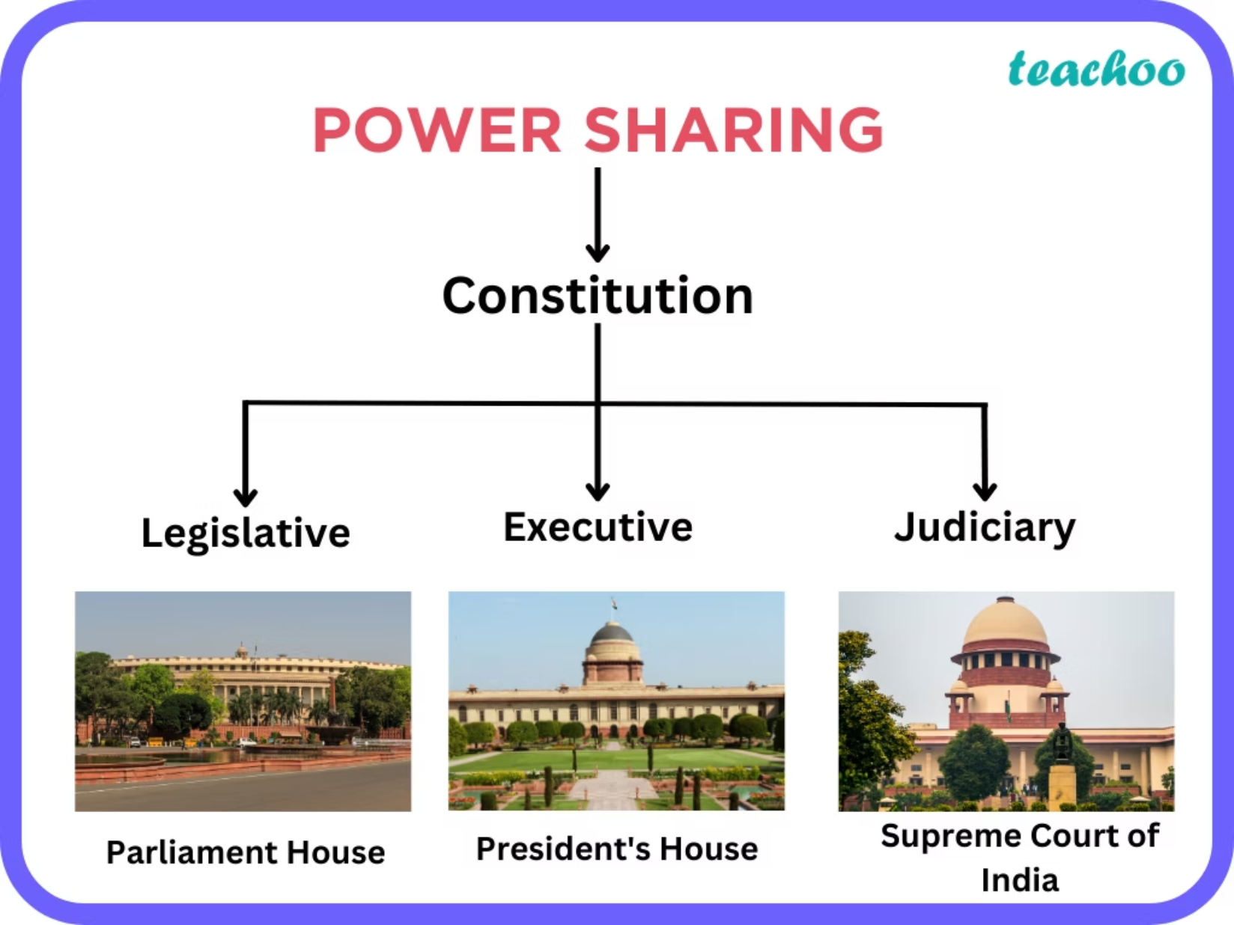
Power Sharing
Dr K S KANNAN,
M.A.,M.A.,M.A., M.Ed.,PGDCA,Ph.D.,
School Assistant in Social Science
ZPHS(B), V KOTA, CHITTOOR DIST,AP.,

Slide 2
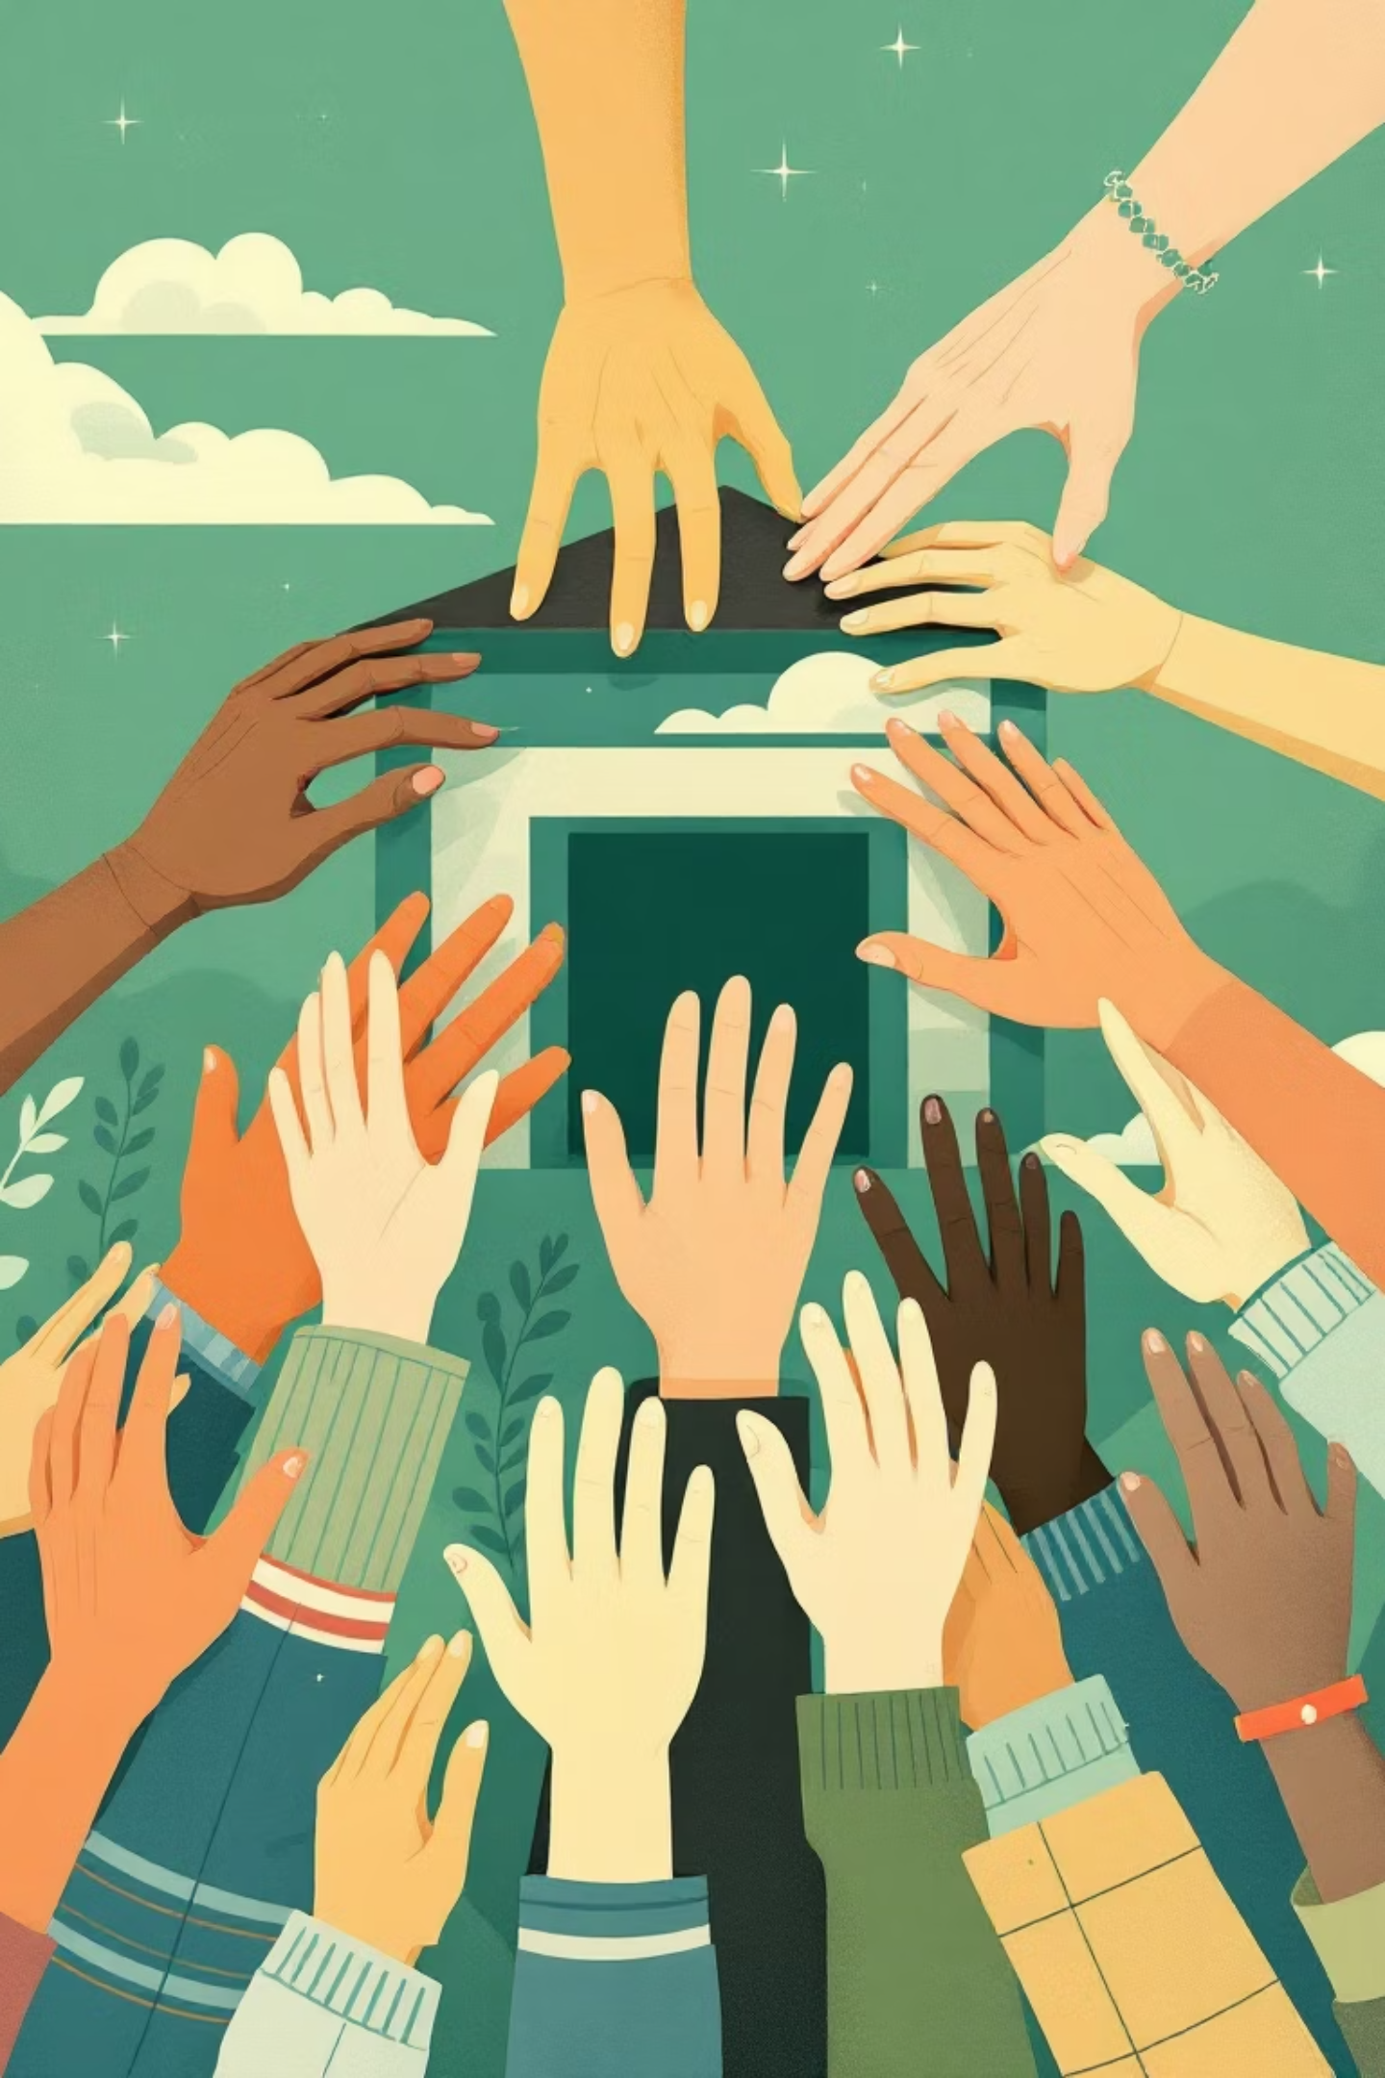
Power Sharing: The Cornerstone of Democracy in India
Power sharing is an indispensable concept in modern democratic governance, particularly relevant in diverse nations like India. It ensures that power is not concentrated in the hands of a single authority, but rather distributed thoughtfully among various entities. This presentation will explore the facets of power sharing, its significance, and practical examples, offering a comprehensive understanding for 10th-grade students.

Slide 3



Unpacking the Concept of Power Sharing
At its core, power sharing signifies the judicious distribution of governmental authority. This strategic allocation aims to prevent the arbitrary exercise of power and promote a balanced, inclusive system of governance. It is a fundamental principle that underpins robust democratic frameworks globally.
Distribution Among Organs
Distribution Across Levels
Prevents Absolute Control
Power sharing involves separating governmental functions and assigning them to distinct organs such as the Legislature, Executive, and Judiciary. This horizontal distribution ensures checks and balances, preventing any single branch from becoming too powerful.
This refers to the vertical sharing of power, where authority is divided among different levels of government, such as the Union (Central), State, and Local administrations. Each level operates within its defined jurisdiction, fostering decentralisation and responsiveness.
The primary objective of power sharing is to dilute the concentration of power, thereby mitigating the risks of authoritarianism and tyranny. It ensures that decisions are made through consensus and broad representation, safeguarding citizens' rights.
A classic example is India, where power is effectively shared among the Parliament (Legislature), the Prime Minister and Council of Ministers (Executive), and the Supreme Court (Judiciary), each acting as a guardian of the constitution and citizens' liberties.

Slide 4
Why is Power Sharing Indispensable for Democracies?
The rationale behind embracing power sharing is twofold: it addresses practical concerns related to stability and conflict avoidance, and it upholds fundamental moral values crucial for a truly democratic society. Both reasons converge to highlight its critical role.
The Prudential Reason
The Moral Reason
Power sharing is a pragmatic choice to reduce the likelihood of conflict between different social groups. By giving diverse communities a stake in governance, it prevents the majority from imposing its will on minorities, thus ensuring political stability and social cohesion. This foresight averts potential civil strife and maintains the peace.
Beyond mere practicality, power sharing is the very spirit of democracy. It acknowledges and respects the inherent right of all people to be consulted and involved in how they are governed. This moral imperative ensures that every voice is heard and every group is represented, making the government legitimate and accountable to its citizens. It fosters active participation and deepens democratic values.

Slide 5
Case Study 1: Belgium’s Exemplary Power Sharing Model
Belgium, a small European nation, serves as a powerful testament to the success of comprehensive power sharing. Despite its complex linguistic diversity, the country managed to craft a unique model that has effectively prevented ethnic conflict and fostered unity.
Linguistic Diversity
Constitutional Safeguards
Special Laws and Majority Support
With a population of approximately 1 crore, Belgium is composed of 59% Dutch speakers (mostly in the Flemish region), 40% French speakers (in the Wallonia region), and 1% German speakers. The capital, Brussels, has a unique demographic where 80% are French speakers and 20% are Dutch speakers.
The Belgian Constitution was amended four times between 1970 and 1993 to accommodate linguistic differences. It mandates that the number of Dutch and French-speaking ministers in the central government must be equal, preventing unilateral decisions by either community.
Certain critical laws require the support of a majority from both linguistic groups in Parliament. This ensures that significant decisions are made through mutual agreement, reinforcing trust and cooperation between the communities.
Community Governments
Successful Outcome
Beyond the central and state governments, Belgium established 'Community Governments' for Dutch, French, and German-speaking communities. These governments have exclusive powers over cultural, educational, and language-related issues, empowering local self-governance and preserving distinct identities.
This intricate and inclusive power-sharing arrangement enabled Belgium to avoid ethnic conflict and political instability, which could have led to the country's division. It stands as a model for how diverse societies can thrive through mutual accommodation.

Slide 6
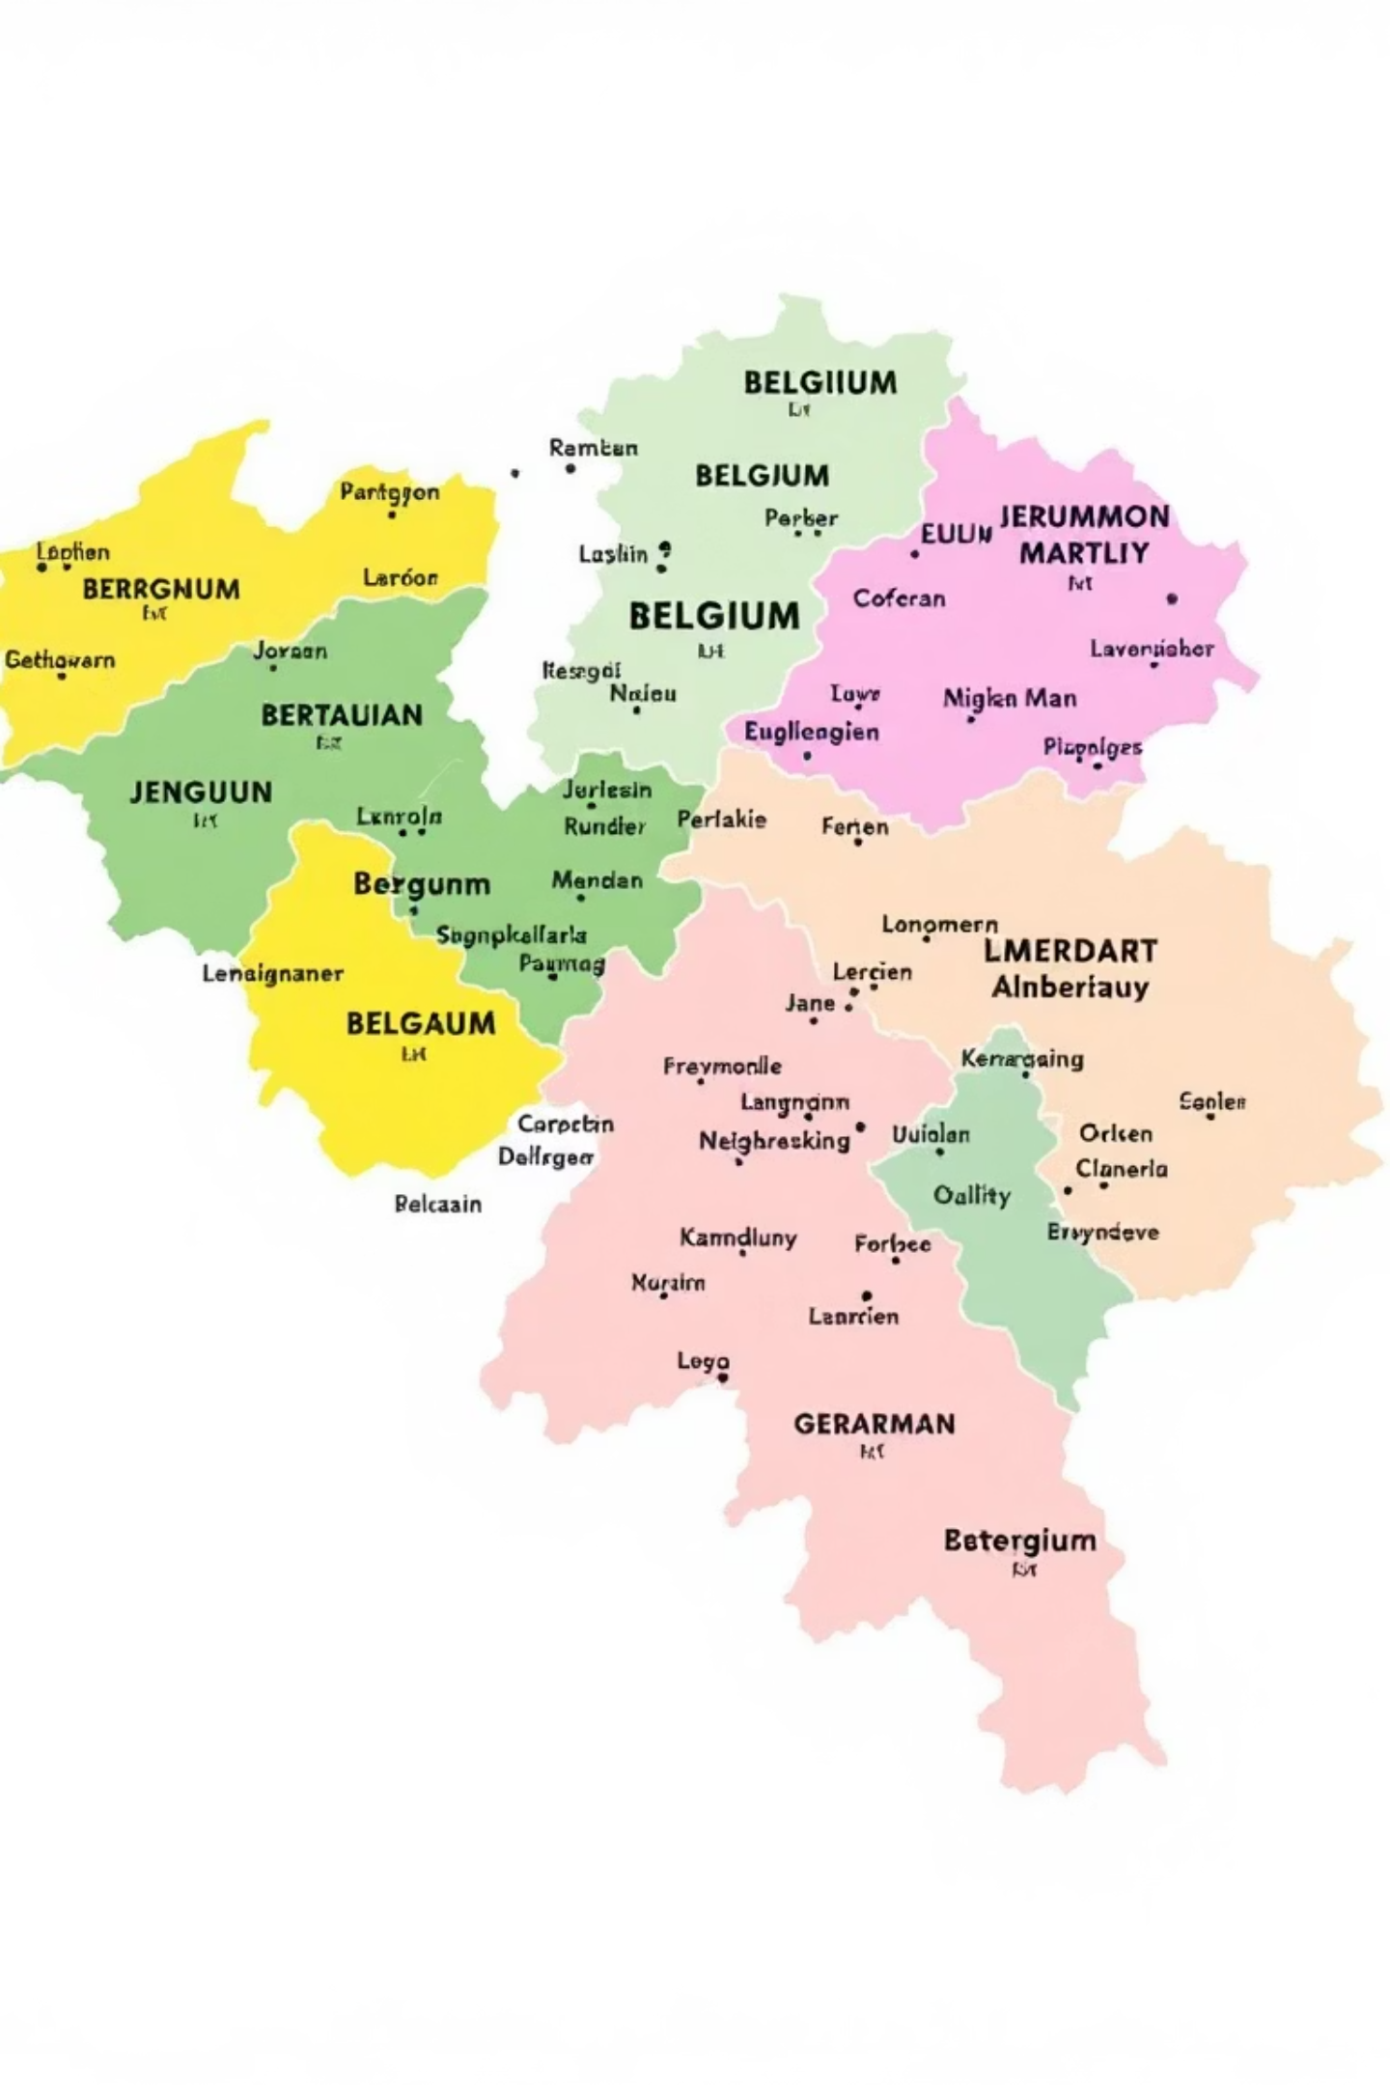
Balancing Diversity Through Power Sharing: The Belgian Model
The map above illustrates Belgium's linguistic divisions, which were expertly managed through innovative power-sharing arrangements. This proactive approach allowed the nation to transform potential conflict into a framework for peace and cooperation, setting an example for other diverse democracies.

Slide 7



Case Study 2: Sri Lanka’s Power Sharing Failure
In stark contrast to Belgium, Sri Lanka's experience highlights the perilous consequences of neglecting power sharing. The nation's failure to accommodate its diverse ethnic groups led to deep resentment and ultimately, a devastating civil war.
Majority Dominance
With a population of approximately 2 crores, Sri Lanka is predominantly Sinhala-speaking (74%), with a significant Tamil-speaking minority (18%). After independence, the Sinhala majority, asserting its dominance, pursued a policy of majoritarianism.
Discriminatory Policies
The government passed laws making Sinhala the only official language, granting preferential treatment to Sinhala applicants for university positions and government jobs. State policies also fostered Buddhism, further marginalising Tamil Hindus and Muslims.
Alienation and Distrust
The Sri Lankan Tamils felt that the government, led by Sinhala leaders, was insensitive to their language and culture. This systematic discrimination led to a profound sense of alienation and increasing distrust between the two communities.
Demand for Autonomy
As relations deteriorated, Tamil political organisations were formed, demanding recognition of Tamil as an official language, regional autonomy, and equality of opportunity in education and jobs. These demands were largely ignored or repressed.
Escalation to Civil War
The denial of legitimate demands and the continued majoritarian policies eventually escalated into a full-blown civil war. Thousands of people from both communities were killed, and many were displaced, causing immense socio-economic devastation.
The Sri Lankan case stands as a stark warning: ignoring the necessity of power sharing in a diverse society can lead to devastating internal conflicts and long-term instability, severely undermining democratic aspirations.

Slide 8








Diverse Forms of Power Sharing in Democracies
Democracies around the world adopt various mechanisms to ensure power is shared effectively. These forms reflect the unique historical and social contexts of different nations, all aiming to foster inclusivity and stability.
Horizontal Sharing
Vertical Sharing
This involves the distribution of power among different organs of government at the same level, such as the Legislature (makes laws), Executive (implements laws), and Judiciary (interprets laws). This system of 'checks and balances' ensures accountability and prevents concentration of power.
Power is shared among governments at different levels – a general government for the entire country (e.g., Union or Federal government) and governments at the provincial or regional level (e.g., State or Local governments). This is known as federalism, allowing for decentralisation and regional autonomy.
Political Parties & Pressure Groups
Community Government
Power can also be shared among different political parties that compete for power. When no single party secures a clear majority, coalitions are formed. Additionally, pressure groups and movements can influence government decisions, representing diverse interests and ensuring broader participation in the political process.
In some countries, power is shared among different social groups, like linguistic or religious communities. This mechanism ensures that minorities are represented and have a say in governance, particularly on issues related to their specific cultural or religious identity, as seen in Belgium.

Slide 9
The Indian Democratic Framework: Power Sharing in Action
India, being the world's largest democracy and a highly diverse nation, has robust power-sharing mechanisms enshrined in its Constitution. These arrangements are crucial for maintaining its unity and integrity amidst a vast array of languages, cultures, and religions.
Horizontal Power Sharing: Separation of Powers
Vertical Power Sharing: Federalism
In India, power is horizontally distributed among the Legislature (Parliament and State Assemblies), the Executive (President, Prime Minister, Council of Ministers), and the Judiciary (Supreme Court, High Courts). Each organ has distinct responsibilities and checks the powers of the others, ensuring accountability and preventing abuse of authority. This system ensures no single branch becomes supreme.
The Indian Constitution provides for a federal system with distinct powers for the Union Government, State Governments, and Local Self-Governments (Panchayati Raj and Municipalities). Subjects are divided into Union List, State List, and Concurrent List, clearly defining their respective jurisdictions. This decentralisation brings governance closer to the people.
Community-Based Power Sharing: Reservation Policies
Power Sharing via Political Parties & Coalitions
To ensure inclusive governance and uplift historically disadvantaged sections, India has reservation policies for Scheduled Castes (SCs), Scheduled Tribes (STs), and Other Backward Classes (OBCs) in legislatures, government jobs, and educational institutions. This ensures their adequate representation and participation in the decision-making process.
India's multi-party system allows for broad representation. When no single party secures a majority, coalition governments are formed, where power is shared among different parties. This fosters consensus and ensures diverse viewpoints are considered in policy-making, reflecting the nation's pluralistic fabric.
These intricate power-sharing arrangements are pivotal in strengthening India's democratic foundations, promoting social harmony, and effectively managing its vast diversity, demonstrating how power sharing can be adapted to large-scale nations.

Slide 10

Essential Takeaways for Future Citizens
Understanding power sharing is not merely an academic exercise; it's about grasping the core mechanisms that make a democracy resilient and just. These key lessons from our study reinforce its undeniable importance:
Cornerstone of Democracy:
Balancing Diverse Interests:
Power sharing is not optional; it's fundamental for the successful functioning and longevity of any democratic system. Without it, the risk of instability and conflict significantly rises.
It serves as a crucial tool to harmonise the varied interests and demands of different social, linguistic, and religious groups. This prevents the dominance of one group over others, fostering equity.
Lessons from Case Studies:
Universal Benefit:
The contrasting experiences of Belgium (success) and Sri Lanka (failure) vividly illustrate the profound consequences – positive and negative – of implementing or neglecting power-sharing arrangements.
Ultimately, every society, irrespective of its size or complexity, benefits from some form of power sharing. It ensures broader participation, promotes social cohesion, and strengthens governance.
By internalising these concepts, you, as students, can become more informed and engaged citizens, capable of advocating for and upholding the principles that make democracies fair and stable.

Slide 11

Conclusion: Power Sharing Builds Strong, Enduring Democracies
In essence, a democracy flourishes best when power is not hoarded but wisely distributed. This deliberate act of sharing responsibilities and decision-making authority creates a more inclusive, stable, and just society for all its members.
Promotes Peace and Justice
Enhances Participation
A Shared Responsibility
It encourages broader citizen engagement, ensuring that diverse voices are heard and considered in the governance process, making the government truly representative of its people.
Understanding power sharing empowers you to appreciate the intricate balance that sustains democracy. It reminds us that sharing power is not just about distributing authority, but also about sharing the collective responsibility of building a progressive nation.
Effective power sharing acts as a bulwark against social strife, fostering an environment where different groups can coexist harmoniously and grievances can be addressed through dialogue and fair process.
As responsible citizens of tomorrow, your comprehension and appreciation of power-sharing principles will contribute directly to the strength and resilience of our democratic future.

